Slide 1
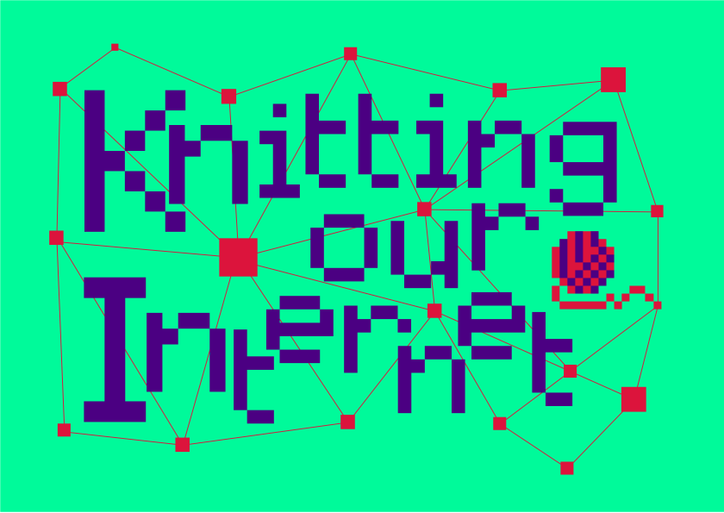

Slide 2
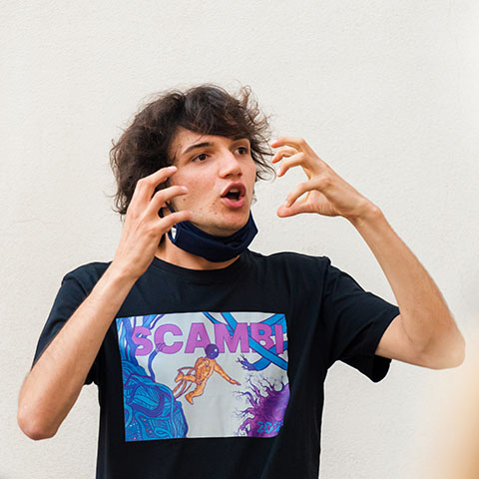
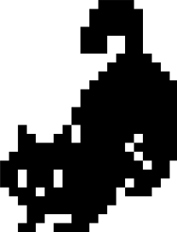

About the creator
https://tommi.space

Slide 3
Decentralization for normies
Face-to-face only
Interactive journey through the history of the Internet
Inter-disciplinary
Inter-generational
International
Accessible

Slide 4
Thanks to my grandma’s yarn

Slide 5
Adaptable and modular
Core module
Main module (discussions and in-depth notions)
History module
Environment module
Fediverse module
???

Slide 6
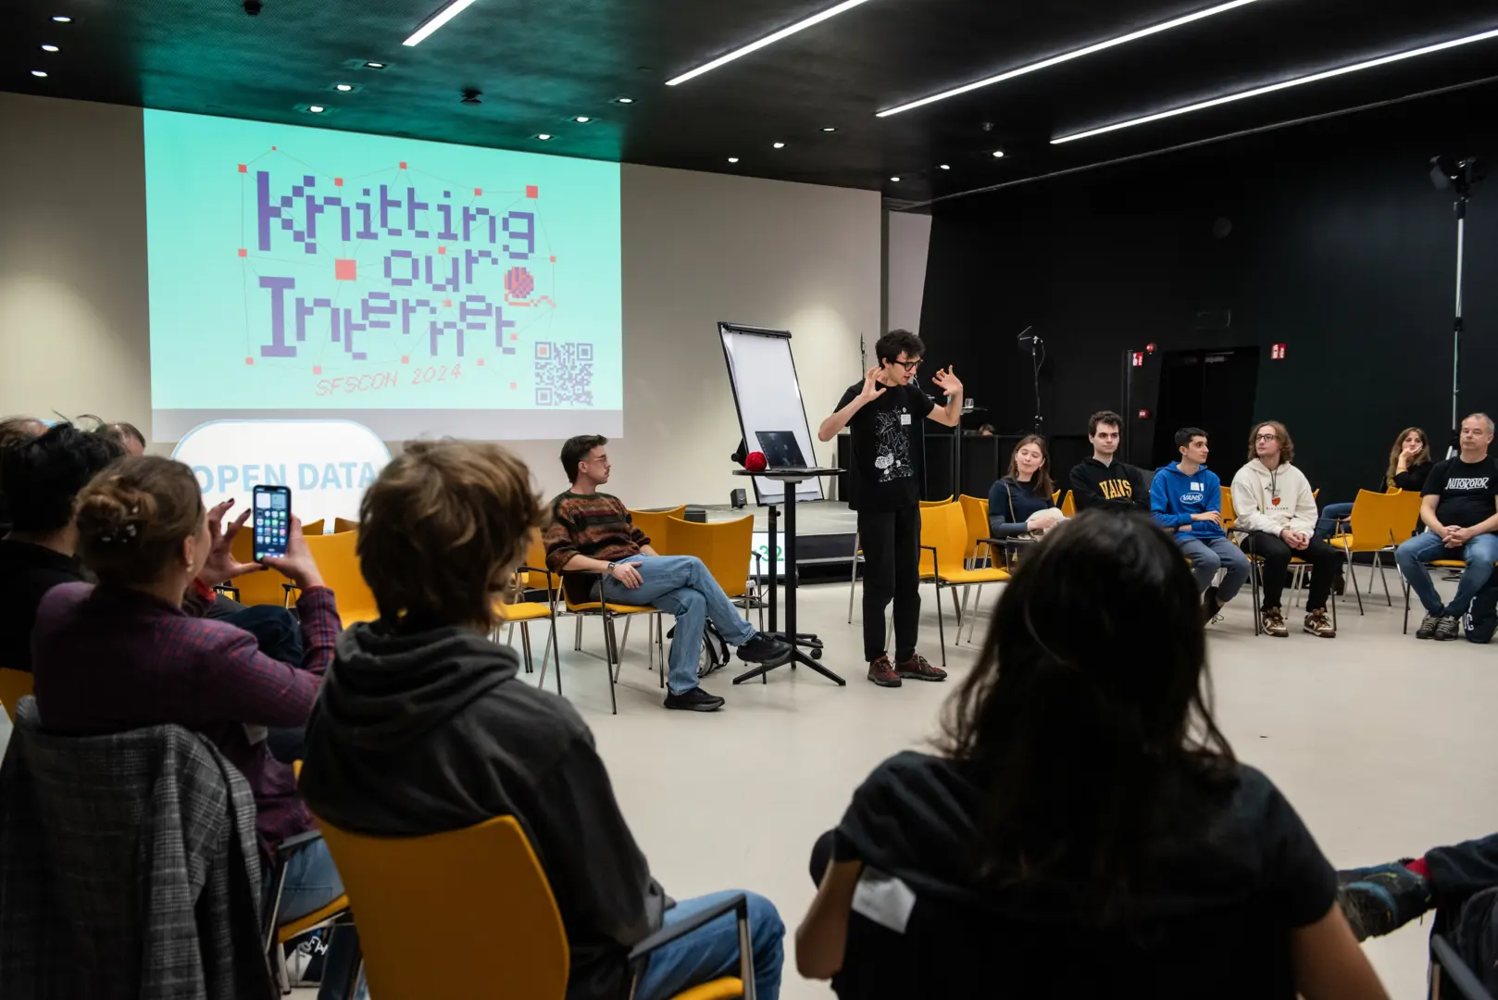
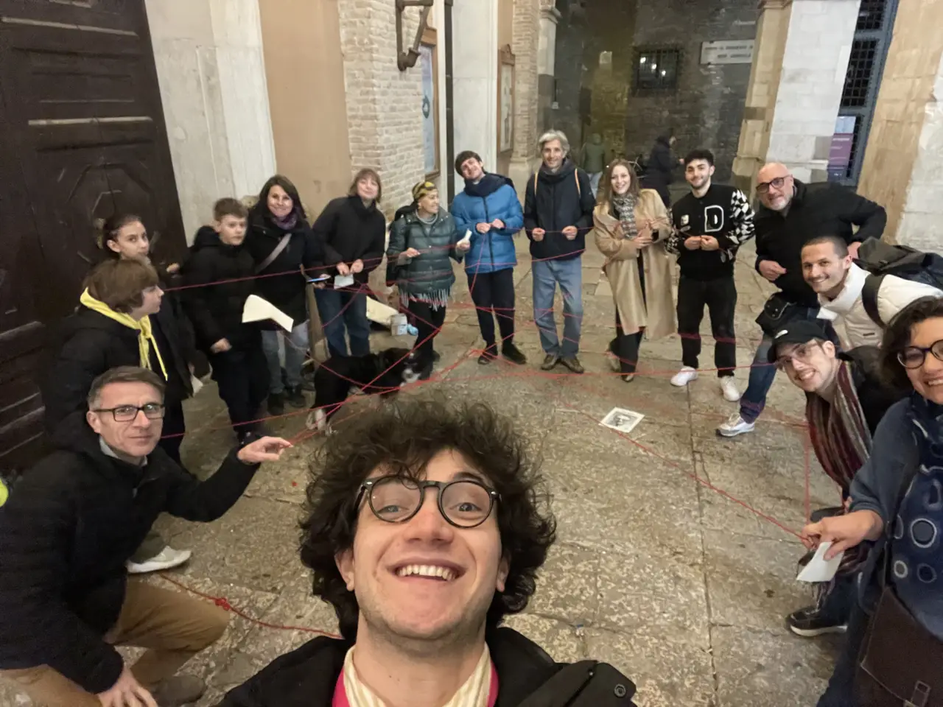
Hosted around Europe

Slide 7
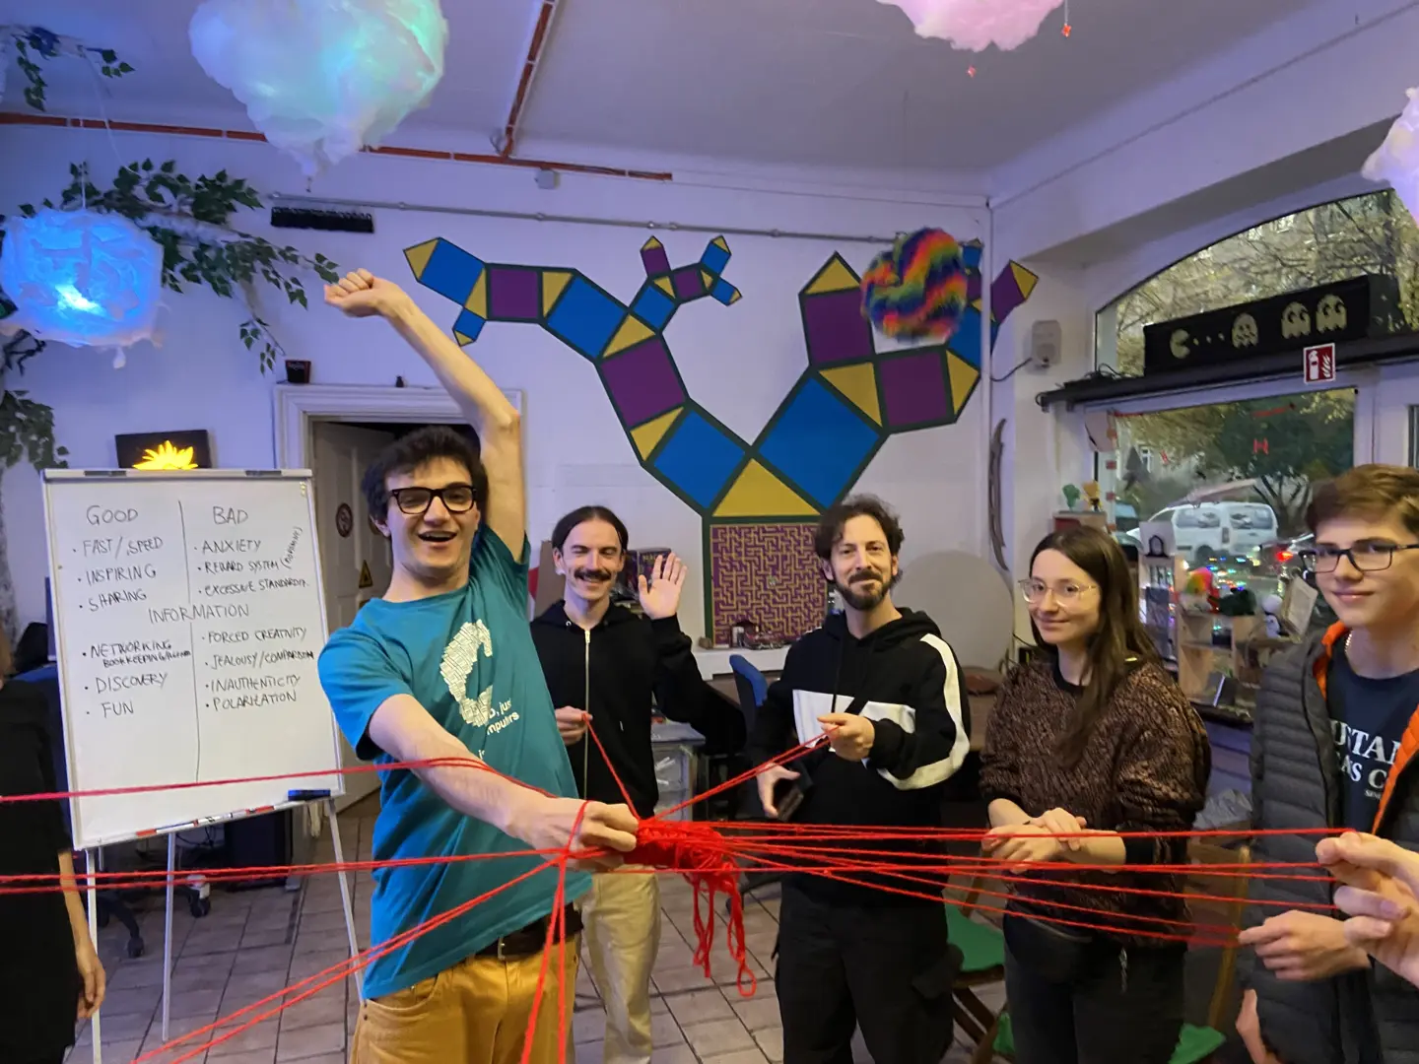
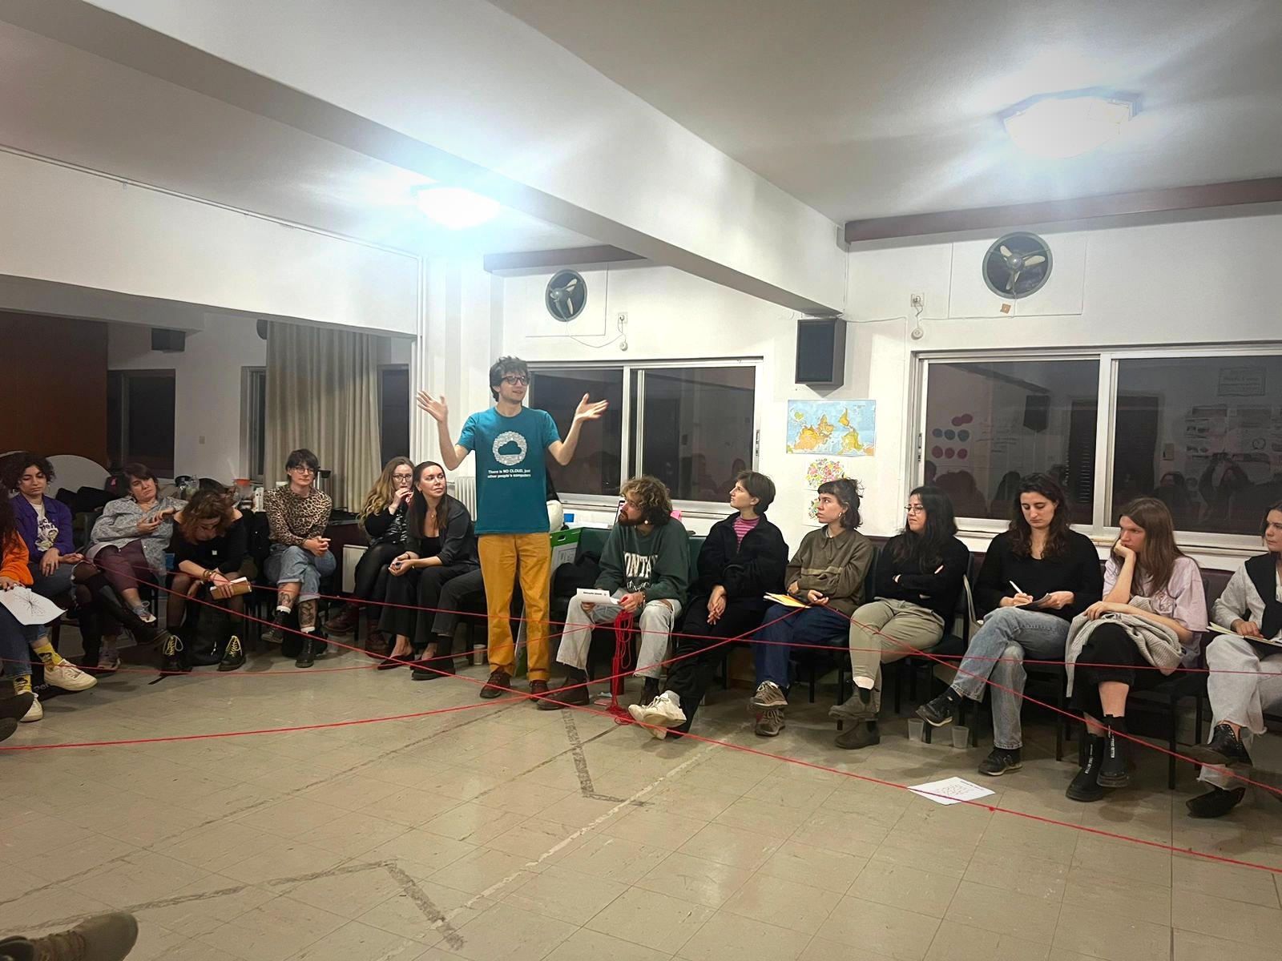
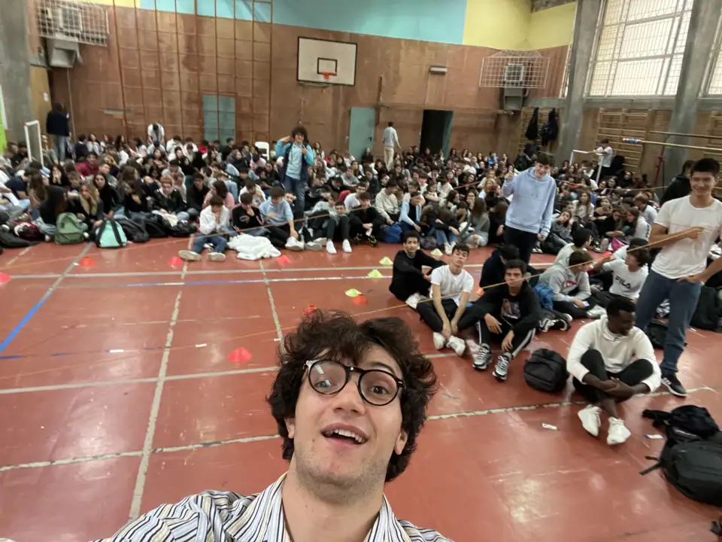
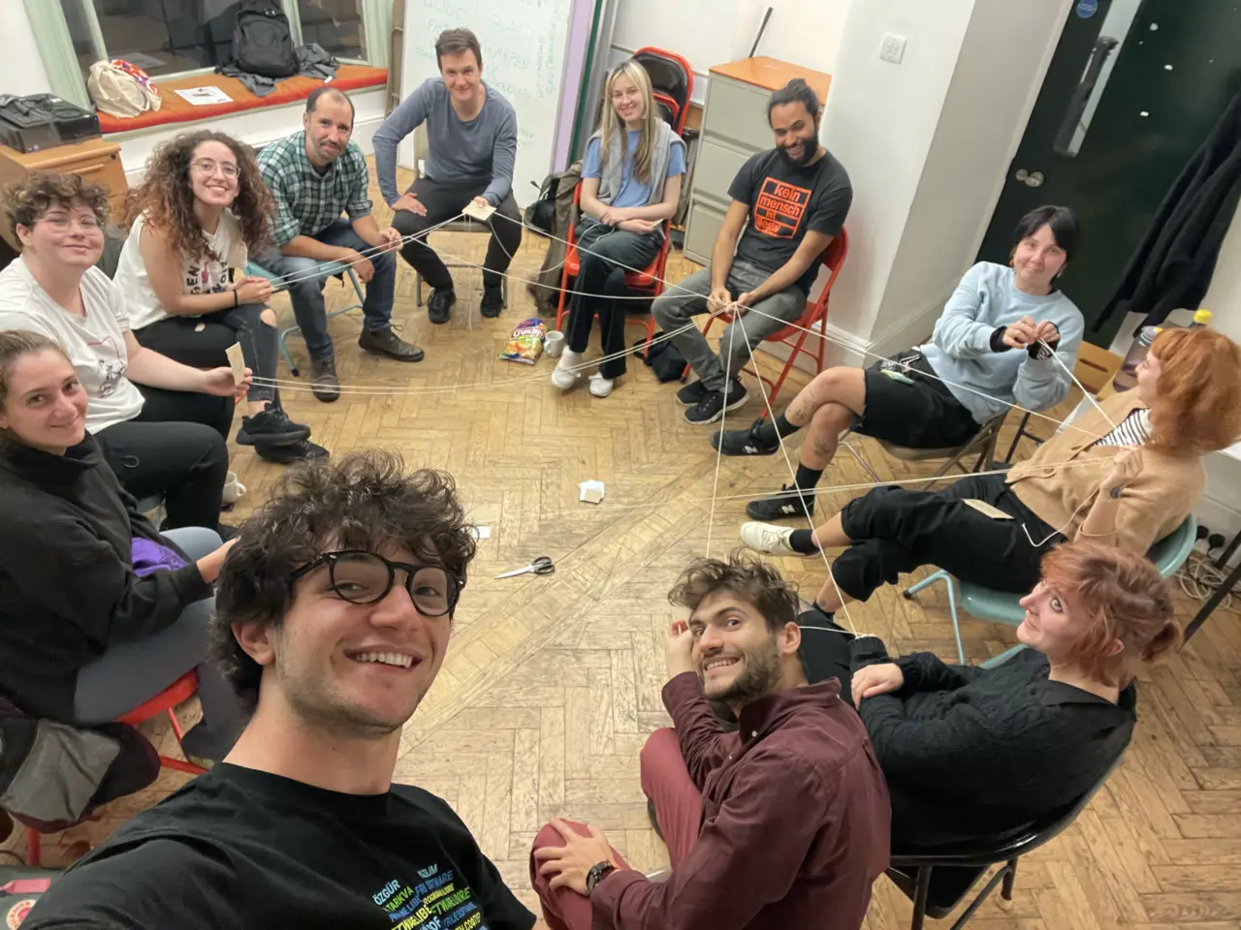
Hosted around Europe

Slide 8
Contribute, make it yours!
Host it yourself, using the Weaver Kit
Make a donation
Add, improve, challenge information
Improve the website’s code
Translate the material
Make art
Spread the word!

Slide 9
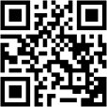
Thanks! Let’s stay in touch!
Everything you need is on https://ournet.rocks/

